Slide 1

Introduction to
Tkinter Template Generator
Hamilton Python User Group
Ian Stewart
12 September 2016
This slide show presentation will be posted on: https://github.com/HamPUG/meetings/

Slide 2
Tkinter Template Generator
This presentation highlights the steps to...
Design a tkinter* GUI program.
Create a design file.
Use a tkinter code generator to read the design file and produce a tkinter template program.
Add the algorithms to the program.
Tailor the GUI layout.
Test.
* Tkinter is a Python binding to the Tk GUI toolkit. It is the standard Python interface to the Tk GUI toolkit, and is Python's de facto standard GUI. The name Tkinter comes from Tk interface. Tkinter was written by Fredrik Lundh.
Tk is a free and open-source, cross-platform widget toolkit that provides a library of basic elements of GUI widgets for building a graphical user interface (GUI) in many programming languages.
https://en.wikipedia.org/wiki/Tkinter

Slide 3
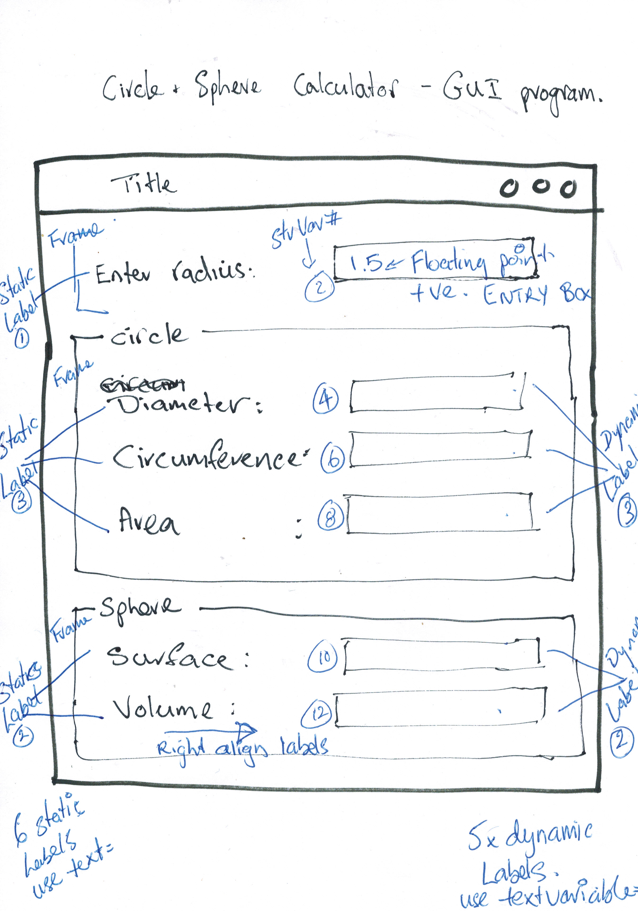
Tkinter Template Generator – Design
Layout...

Slide 4
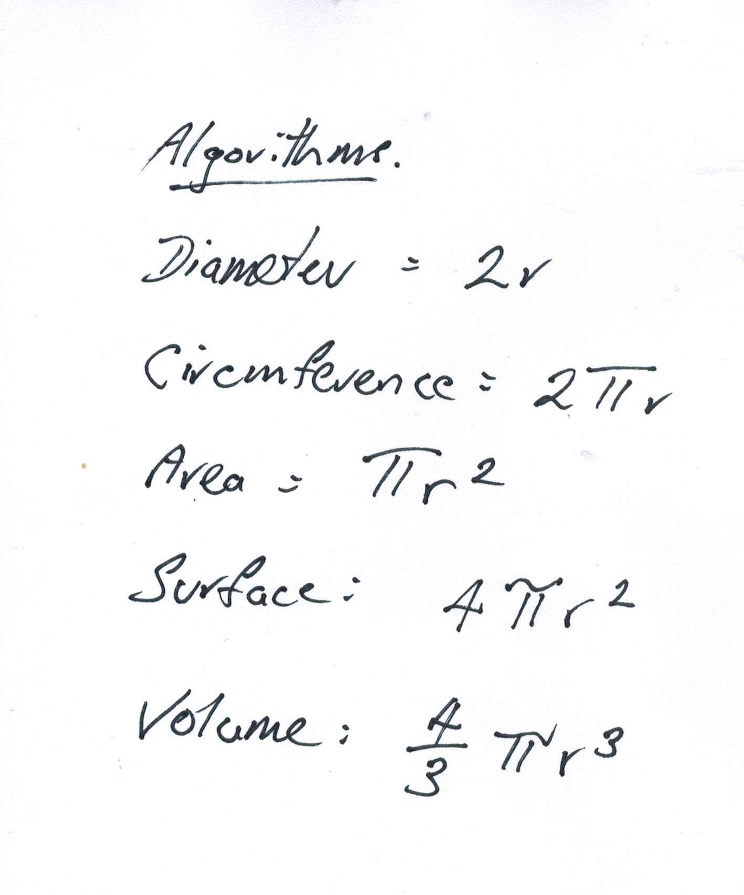
Tkinter Template Generator – Design
Research algorithms...

Slide 5
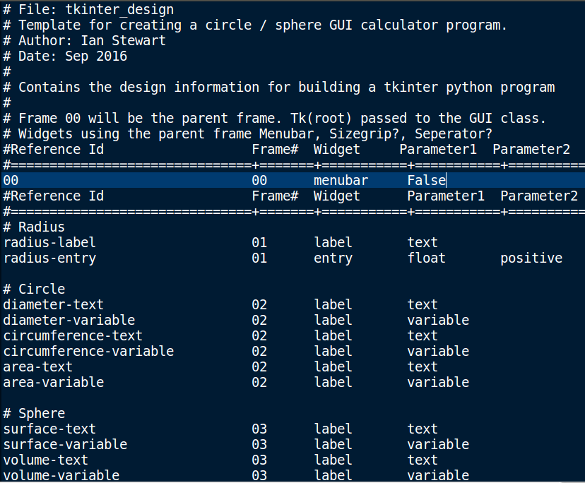
Tkinter Template Generator – Design
Edit Design file...

Slide 6
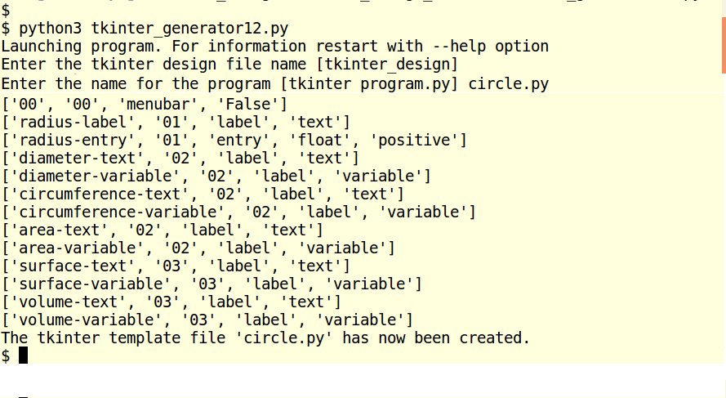
Tkinter Template Generator – Create
Run tkinter template generator, then launch program...

Slide 7
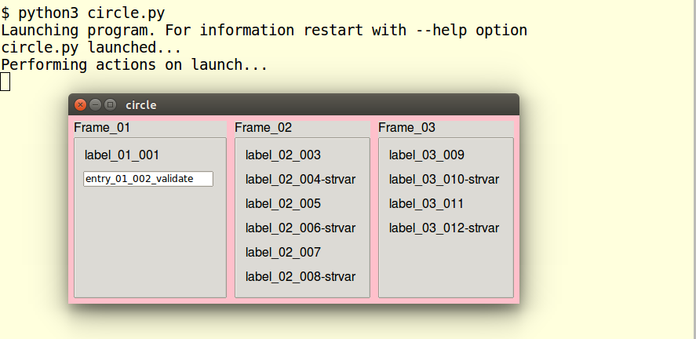
Tkinter Template Generator – Create
Run tkinter template generator, then launch program...

Slide 8
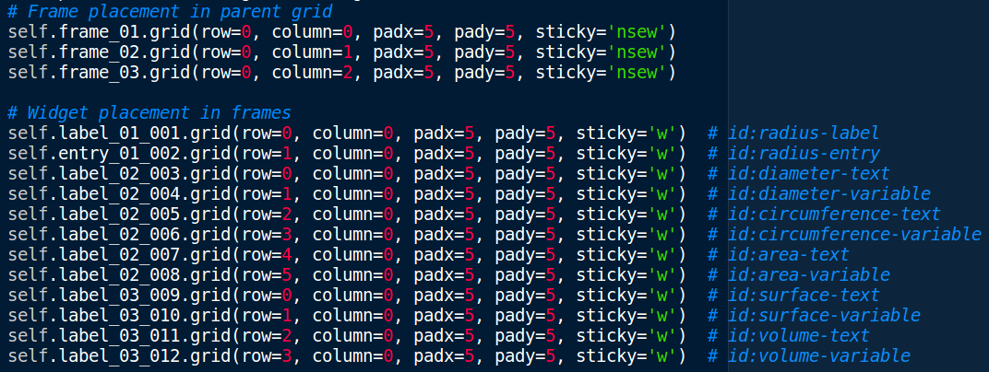
Tkinter Template Generator – Tailoring
Editing circle.py grid geometry. Before...

Slide 9
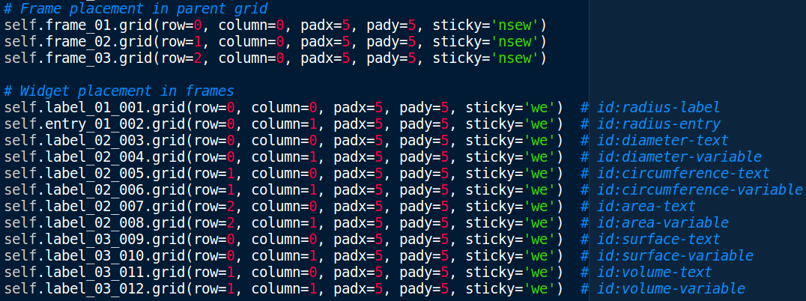
Tkinter Template Generator – Tailoring
Editing circle.py.py grid geometry. After...

Slide 10
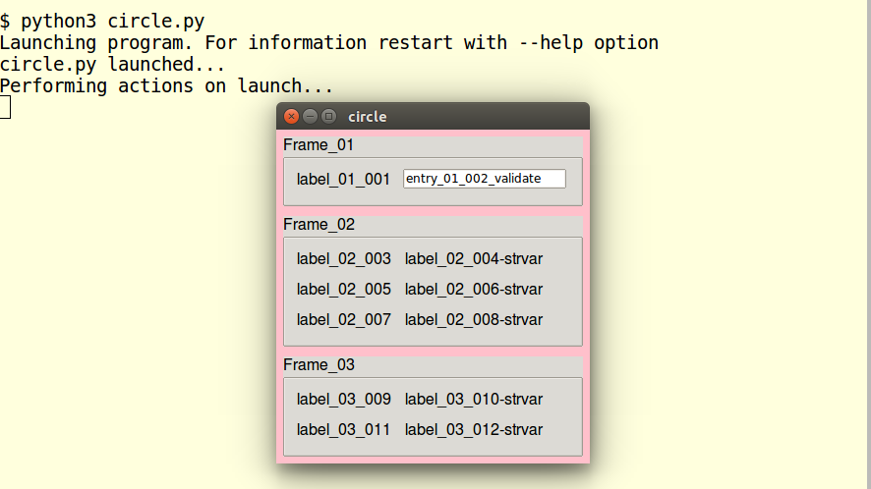
Tkinter Template Generator – Tailoring
After editing circle.py has two columns in each frame...

Slide 11
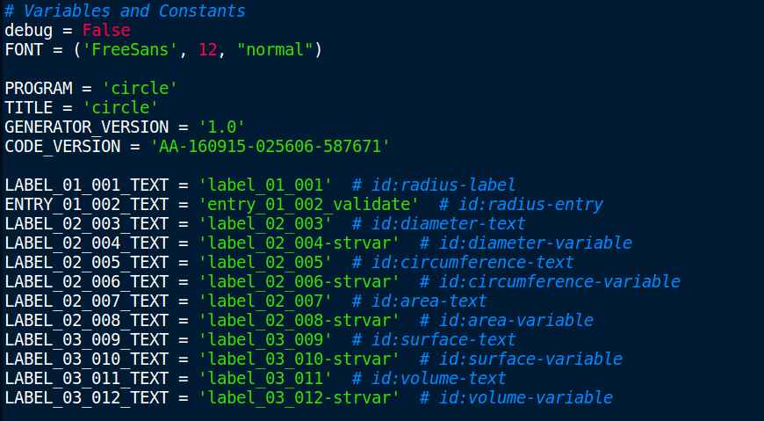
Tkinter Template Generator – Tailoring
Editing circle.py constants. Before...

Slide 12
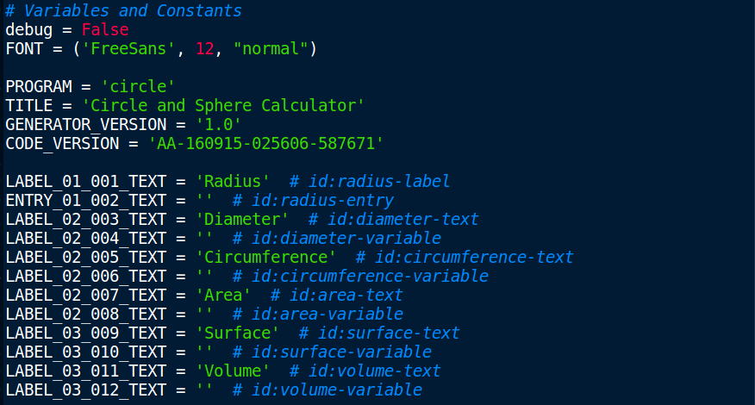
Tkinter Template Generator – Tailoring
Editing circle.py constants. After...

Slide 13
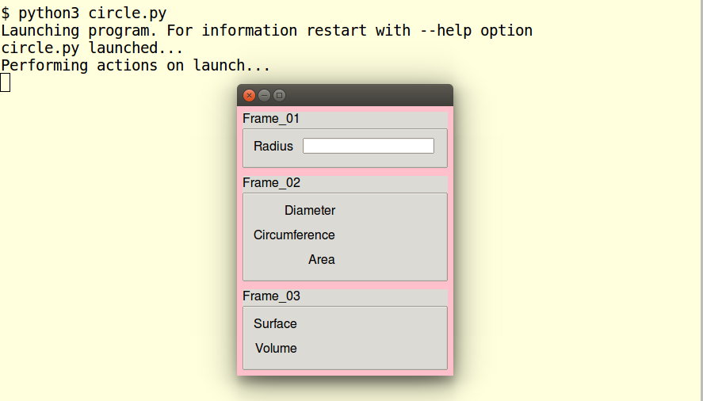
Tkinter Template Generator – Tailoring
After editing circle.py constants...

Slide 14
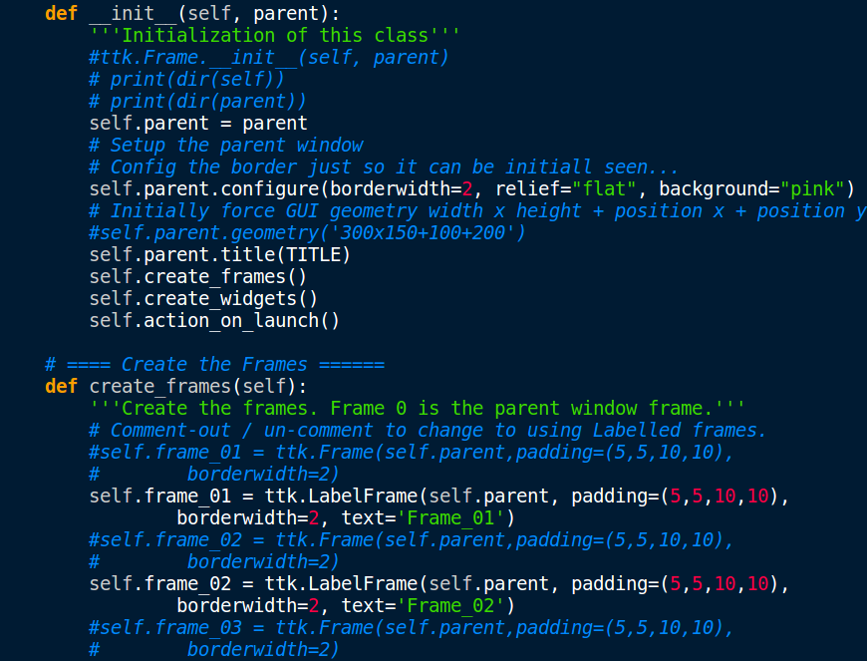
Tkinter Template Generator – Tailoring
Editing circle.py frame text. Before...

Slide 15
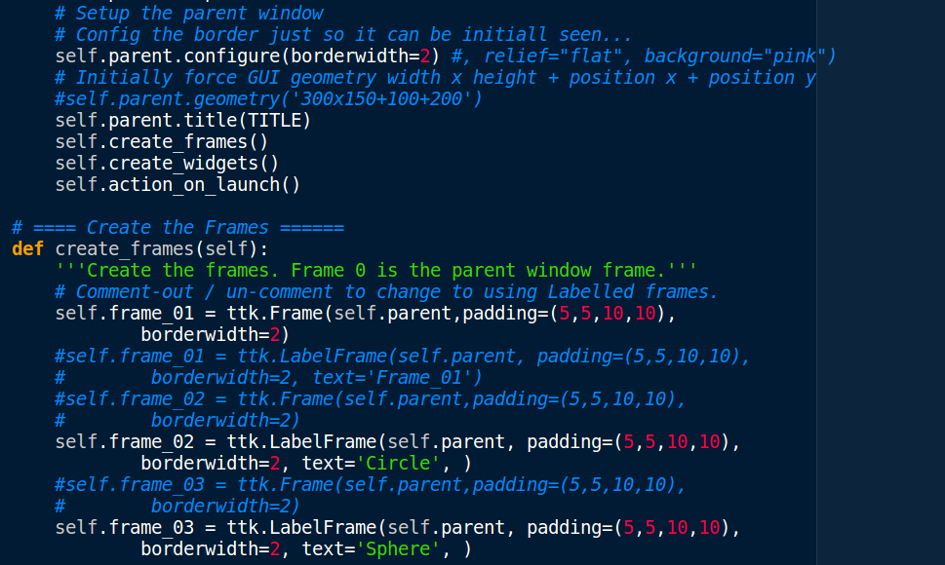
Tkinter Template Generator – Tailoring
Editing circle.py frame text. After...

Slide 16
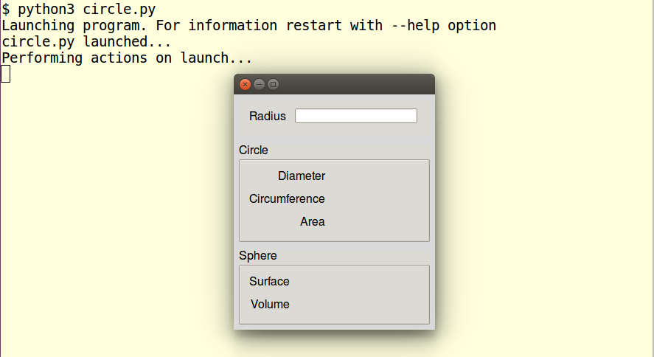
Tkinter Template Generator – Tailoring
Editing circle.py frame text. After...

Slide 17
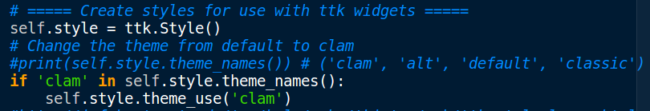
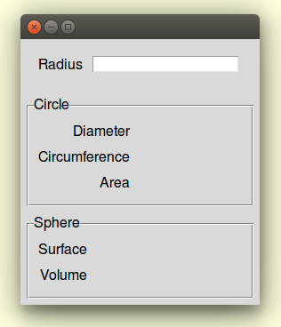
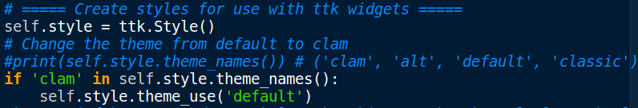
Tkinter Template Generator – Tailoring
Editing circle.py Style. Before...
After...

Slide 18
Tkinter Template Generator – Flow
Entry box Callback
def entry_validate(info x 8):
info good? float?
calculate(value)
return True
else:
return False
Validation
Radius Data
8 x variables
GUI Display
validatecommand=vcmd
Radius
Entry box
String Variables
textvariable=strvar
def calculate(radius):
2 * radius
2 * Pi * radius
Pi * radius **2
4 * Pi * radius **2
4/3 * Pi * radius **3
Diameter
Diameter
Label
Circumference
Circumference
Label
Area
Area
Label
Surface
Surface
Label
Volume
Volume
Label

Slide 19
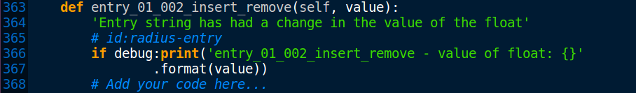
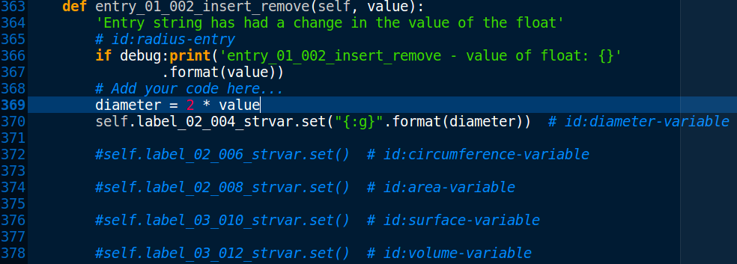
Tkinter Template Generator – Tailoring
Editing circle.py algorithm to Entry callback. Before...
In progress...

Slide 20
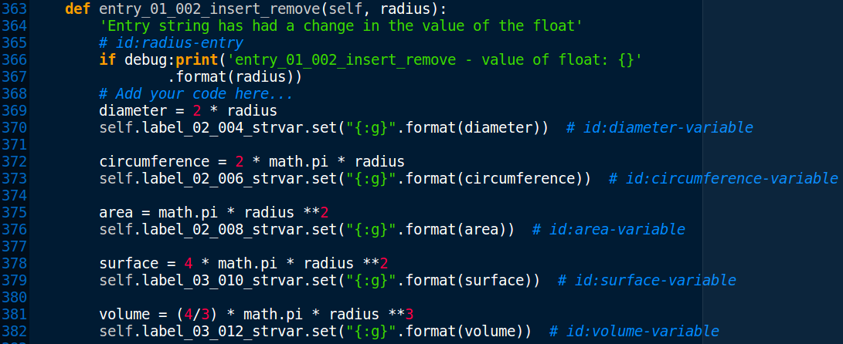
Tkinter Template Generator – Tailoring
Editing circle.py algorithm to Entry callback. After...

Slide 21

Tkinter Template Generator – Tailoring
Editing circle.py algorithm methods.
Add math module for pi...
After...

Slide 22
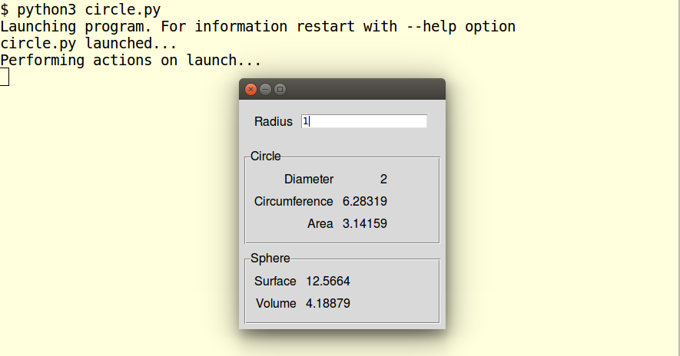
Tkinter Template Generator – Tailoring
Editing circle.py algorithms completed...

Slide 23
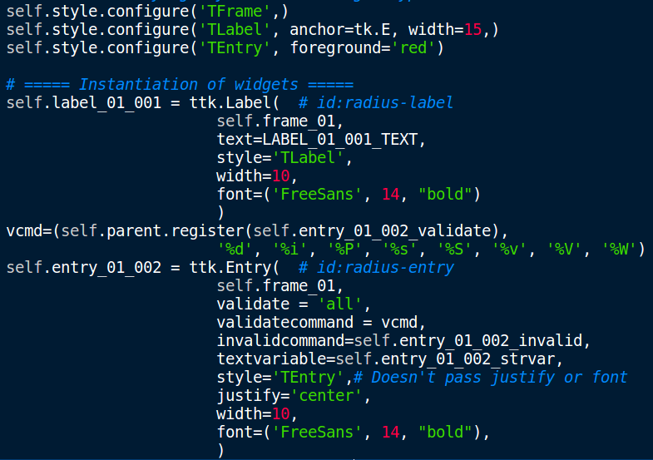
Tkinter Template Generator – Tailoring
Additional tailoring. Radius Entry features, anchoring East...

Slide 24
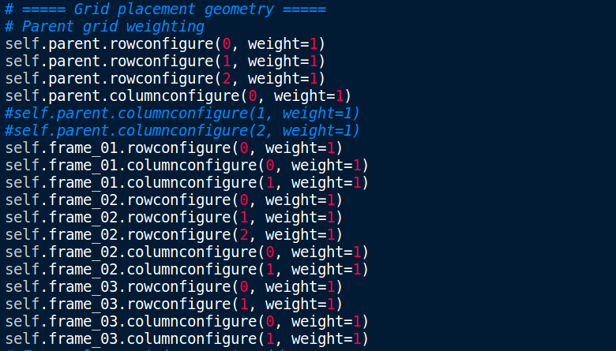
Tkinter Template Generator – Tailoring
Additional tailoring. Weighting to allow frame stretching...

Slide 25
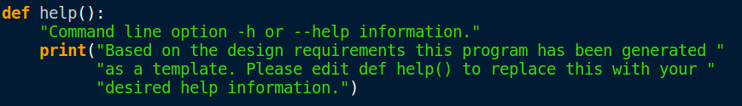
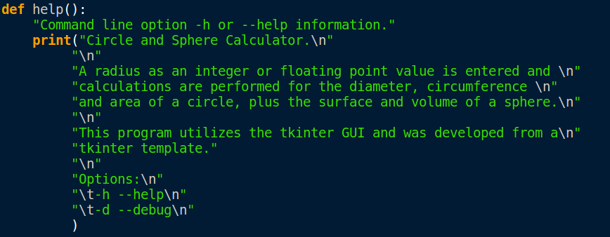
Tkinter Template Generator – Tailoring
Help. Before...
Help. After...

Slide 26
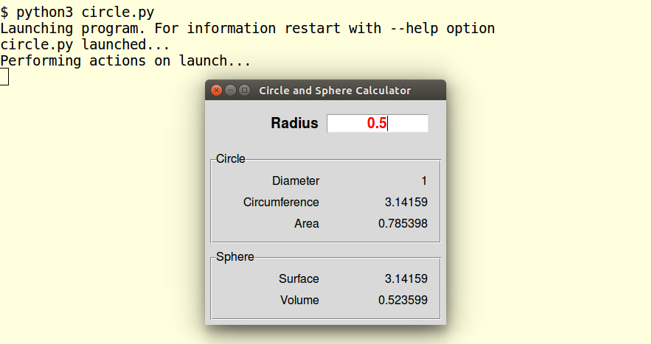
Tkinter Template Generator – Complete
Normal notation...

Slide 27
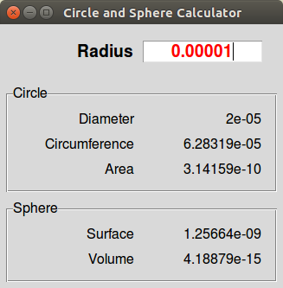
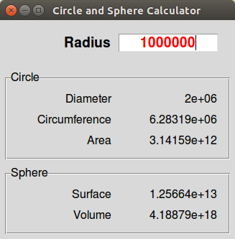
Tkinter Template Generator – Complete
Automatic scientific notation tests...

Slide 28
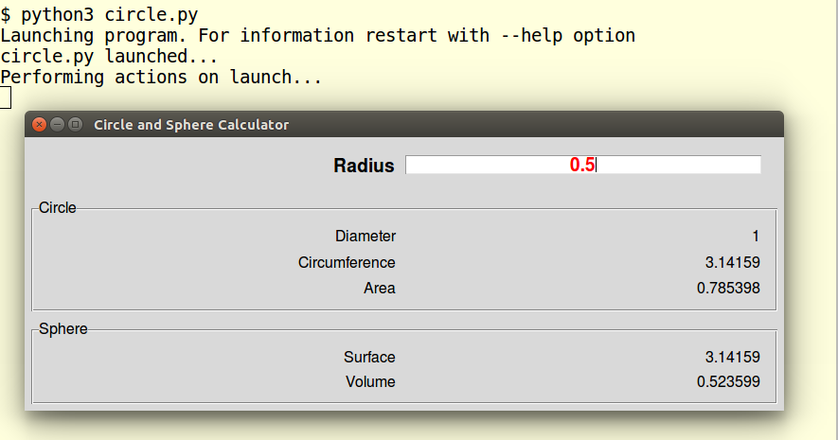
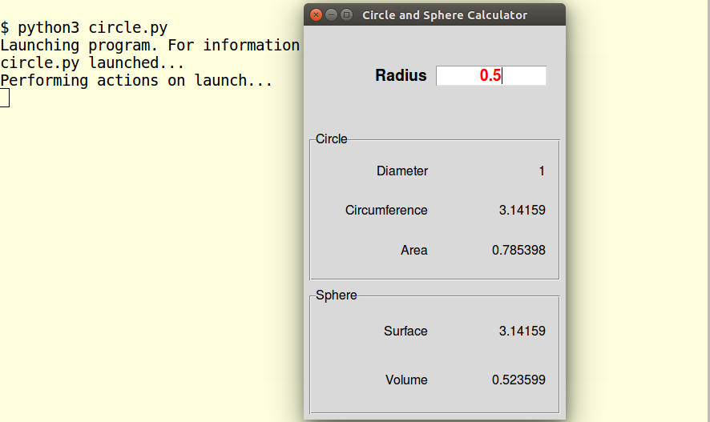
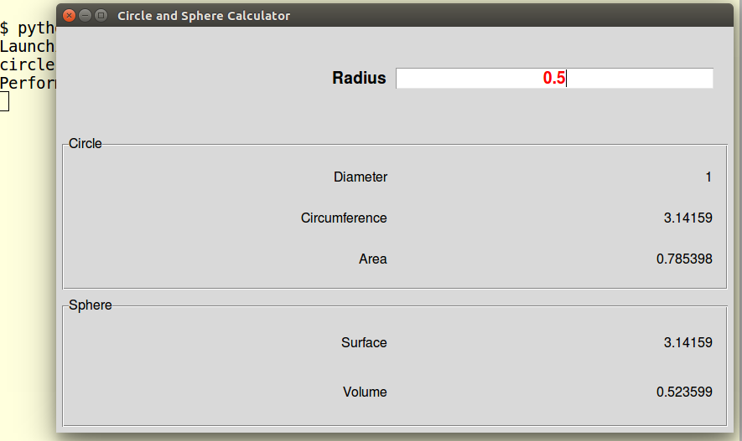
Tkinter Template Generator – Complete
Stretching tests...

Slide 29
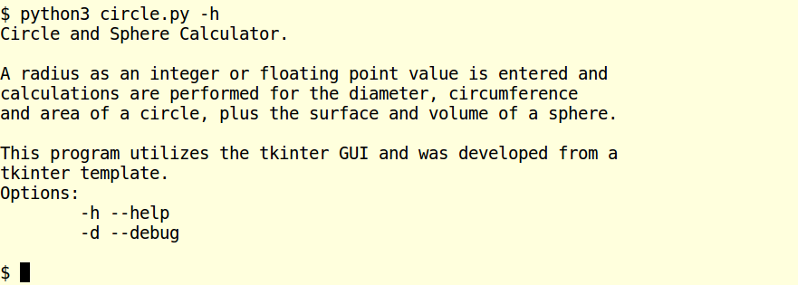
Tkinter Template Generator – Complete
Help...

Slide 30
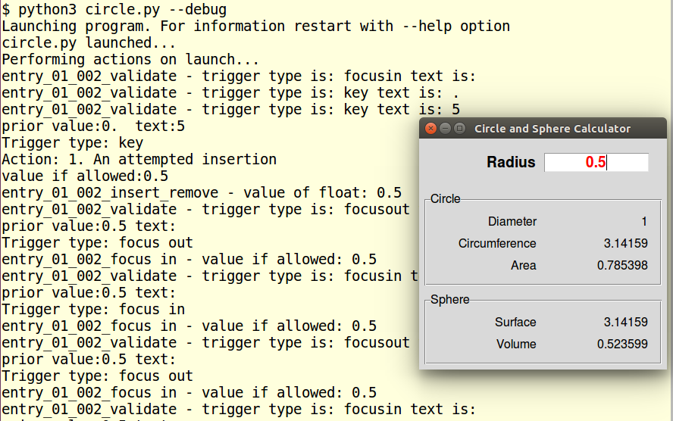
Tkinter Template Generator – Complete
Debug...

Slide 31
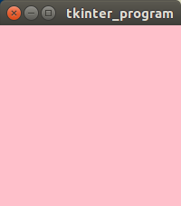
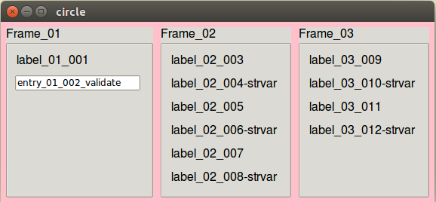
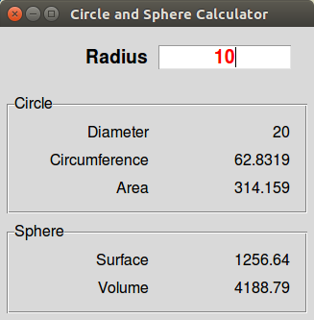
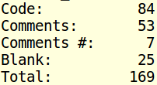
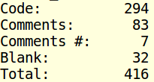
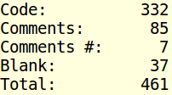
Tkinter Template Generator – Lines of code
Tkinter Template Generator – Lines of code
Tkinter Template Generator – Lines of code
Blank design
Widgets added
Final
84 code lines
25% overall
210 code lines added
63% overall
38 code lines added.
12% overall
Algorithm=11 lines

Slide 32
Tkinter Template Generator – Activities
 | Activity | Minutes
1 | Design GUI layout and functionality on paper
2 | Research algorithms – area & volume of sphere
3 | Editing of design template to add widgets
4 | Run generator – create template GUI code
5 | Launch GUI template code and test
6 | Edit GUI code. Grid, constants, frame, style
7 | Check GUI looks OK
8 | Create algorithm function
9 | Test algorithm
10 | Clean-up. Entry box, font-size, alignment, stretching,
 | Total

Slide 33
Tkinter Template Generator – Time Taken
GUI related: 30 (54%), Design/Research: 10 (18%), Algorithm – writing python code: 16 (28%)
 | Activity | Minutes
1 | Design GUI layout and functionality on paper | 8
2 | Research algorithms – area & volume of sphere | 2
3 | Editing of design template to add widgets | 6
4 | Run generator – create template GUI code | 1
5 | Launch GUI template code and test | 1
6 | Edit GUI code. Grid, constants, frame, style | 6
7 | Check GUI looks OK | 1
8 | Create algorithm function | 15
9 | Test algorithm | 1
10 | Clean-up. Entry box, font-size, alignment, stretching, | 15
 | Total | 56

Slide 34
Components of Tkinter Template Program
Shebang
Comments
Copyright
Class GUI(self, parent)
Help
Message
Create frames
Main
root = tk.Tk()
GUI(root)
root.mainloop()
Import modules
Python3 check
Create widgets
Variables
Styles
Instantiation
Grid Weighting
Grid placement
Variables
Constants
Start
sys.argv
- help
- debug
main()
Action on launch
Callbacks
Perform actions

Slide 35
Introduction to
Tkinter Template Generator
Any Questions?
Any Suggestions?
__end__

Slide 36
Additional Notes
Digital Technologies NCEA Level3 unit 91637 "Develop a complex computer program for a specified task". The achievement standard requires the program to have a graphical user interface. Although, “any code that is auto-generated by an Integrated Development Environment (IDE) cannot be used as evidence of student code” the use of templates may help with initially learning tkinter.
The tkinter template generator program used in this presentation is currently undergoing further development.
Also a tkinter GUI designer application is available.
Pygubu. (Inspired by Glade).
https://github.com/alejandroautalan/pygubu
https://pypi.python.org/pypi/pygubu

